Slide 1
Boosting Algorithms
Kuppusamy S

Slide 2
Purpose and Types of Boosting Algo
We need boosting algorithms to improve the accuracy of weak classifiers by combining them into a stronger model, thereby enhancing overall predictive performance.
There are:
Ada Boosting
XG Boosting
LG Boosting

Slide 3
1.Ada Boost
Definition:
AdaBoost, short for Adaptive Boosting, is a machine learning algorithm that
combines multiple weak classifiers into a strong classifier by adjusting the
weights of misclassified points.
Origin:
Developed by Yoav Freund and Robert Schapire in 1995.
Purpose:
Boosts the performance of algorithms by focusing on the most challenging cases.

Slide 4
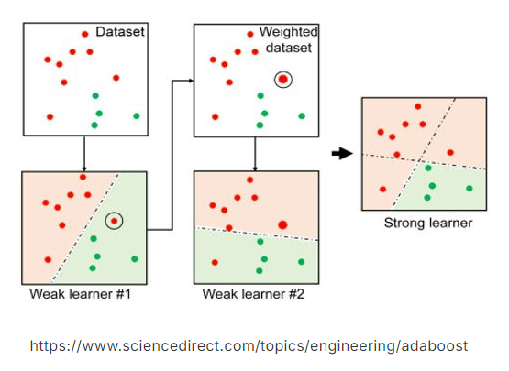
Ada Boost – How it works

Slide 5
Ada Boost – Advantages & Limitations
Advantages:
High accuracy: Often improves the performance of weak learners.
Versatility: Can be used with various base classifiers.
No overfitting: Less prone to overfitting compared to other algorithms.
Limitations:
Sensitive to noisy data: Performance may degrade with outliers.
Computationally expensive: Requires multiple iterations for convergence.
Weakness: Effectiveness depends on the choice of base classifiers.

Slide 6
Ada Boost - Applications
Image Recognition: Used in face detection and object classification in autonomous systems.
Text Classification: Enhances spam detection and sentiment analysis in emails and social media.
Healthcare: Improves disease prediction and medical image analysis (e.g., tumor detection).
Fraud Detection: Identifies fraudulent activities in financial transactions and insurance claims.
Customer Behavior: Predicts customer churn and enhances recommendation systems.
Speech Recognition: Improves accuracy in voice command recognition and speaker identification.
Finance: Aids in stock price prediction and risk assessment.

Slide 7
2.XG Boost
Definition:
XGBoost (Extreme Gradient Boosting) is a powerful machine learning algorithm
based on gradient boosting, designed for speed and performance.
Origin:
Developed by Tianqi Chen in 2014 as part of the Distributed (Deep) Machine Learning
Community (DMLC) group. It quickly gained popularity for its efficiency and scalability.
Purpose:
XGBoost is designed to optimize both the computational speed and predictive accuracy
of models, particularly in large-scale and high-dimensional data settings.

Slide 8
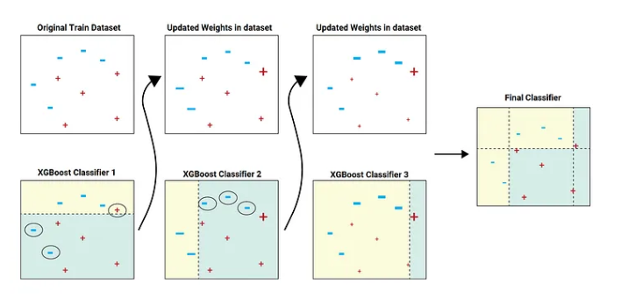
XG Boost– How it works

Slide 9
XG Boost - Applications
Finance: Widely used in predicting stock prices, credit scoring, and detecting fraudulent transactions.
Healthcare: Applied in disease prediction, patient outcome forecasting, and medical image analysis.
Marketing: Helps in customer segmentation, churn prediction, and personalized recommendation systems.
Competition Success: Frequently used by data scientists to win machine learning competitions on platforms like Kaggle.
Retail: Used in demand forecasting, inventory management, and optimizing supply chain processes.

Slide 10
XG Boost – Advantages & Limitations
Advantages:
High Performance: Fast execution and high accuracy, making it suitable for large datasets.
Regularization: Includes built-in L1 and L2 regularization, reducing the risk of overfitting.
Flexibility: Supports various objective functions and can be used for regression, classification.
Parallel Processing: Efficiently handles large datasets with parallel computing, making it scalable.
Limitations:
Complexity: Can be complex to tune and requires careful parameter optimization for best results.
Overfitting Risk: Although mitigated by regularization, there’s still a risk of overfitting, especially small datasets
Resource Intensive: Requires significant computational resources and memory, particularly with large datasets.

Slide 11
3.LG Boost
Definition:
LightGBM (Light Gradient Boosting Machine) is a gradient boosting framework designed for high efficiency, speed, and scalability, particularly with large datasets.
Origin: Developed by Microsoft in 2016, LightGBM is part of the open-source Distributed Machine Learning Toolkit (DMTK) and was created to address the limitations of other gradient boosting methods.
Purpose: LightGBM aims to provide faster training times and lower memory usage while maintaining or improving model accuracy, making it ideal for large-scale data applications.

Slide 12
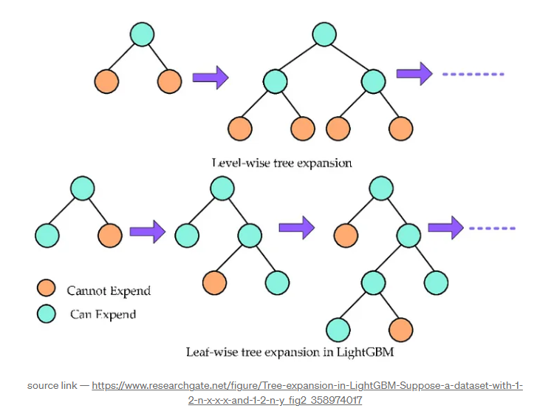
LG Boost– How it works

Slide 13
LG Boost – Advantages & Limitations
Advantages:
High Speed: Optimized for fast training, especially with large datasets and high-dimensional data.
Efficiency: Consumes less memory and computational resources compared to other boosting algorithms.
Scalability: Supports distributed training, making it suitable for big data scenarios.
Accuracy: Provides competitive accuracy, particularly with large and complex datasets.
Limitations:
Complexity in Tuning: Like other boosting algorithms, it requires careful tuning of hyperparameters for
optimal performance.
Sensitivity to Overfitting: Despite regularization, there’s a risk of overfitting, particularly with small datasets.
Limited Interpretability: As with most gradient boosting methods, the resulting models can be
difficult to interpret.

Slide 14
LG Boost - Applications
Finance:
Used in credit scoring, risk assessment, and fraud detection, thanks to its speed and accuracy with large
datasets.
E-commerce:
Applied in product recommendation systems, customer segmentation, and sales forecasting.
Healthcare:
Employed in predictive modeling for patient outcomes, disease diagnosis, and genomic data analysis.
Marketing:
Helps in predicting customer churn, optimizing marketing campaigns, and personalizing user experiences.
Technology:
Frequently used in machine learning competitions for tasks like click prediction, ranking, and anomaly
detection due to its scalability and performance.

